Slide 1
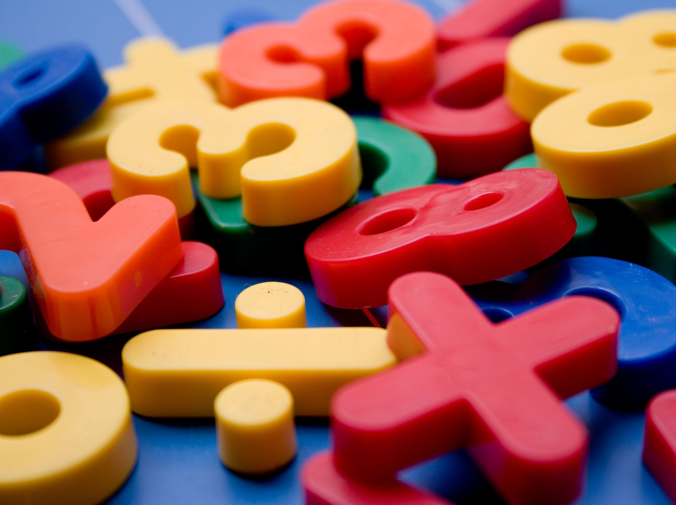
Mathematics at ghyllgrove
Years 1 and 2
Mr Dale Collins
Year 2 Teacher
Key Stage 1 Lead
Mathematics Lead
Notes:
dcollins teacher

Slide 2
Today’s aims…
Give you an overview of the Year 1 and 2 curriculum for Maths.
Look at how calculation is taught in Year 1 and 2.
Ideas for supporting Maths at home.
Update on E-Safety

Slide 3
What do we want for the children at ghyllgrove?
Confidence
Fluency
Strong arithmetic skills
Skills for Life
Enjoyment of the Subject
Having fun

Slide 4

Maths
Fractions, algebra, etc
Written and mental methods for + - x /
Mathematical Language
Counting
Number Bonds
Number Facts
Times Tables

Slide 5
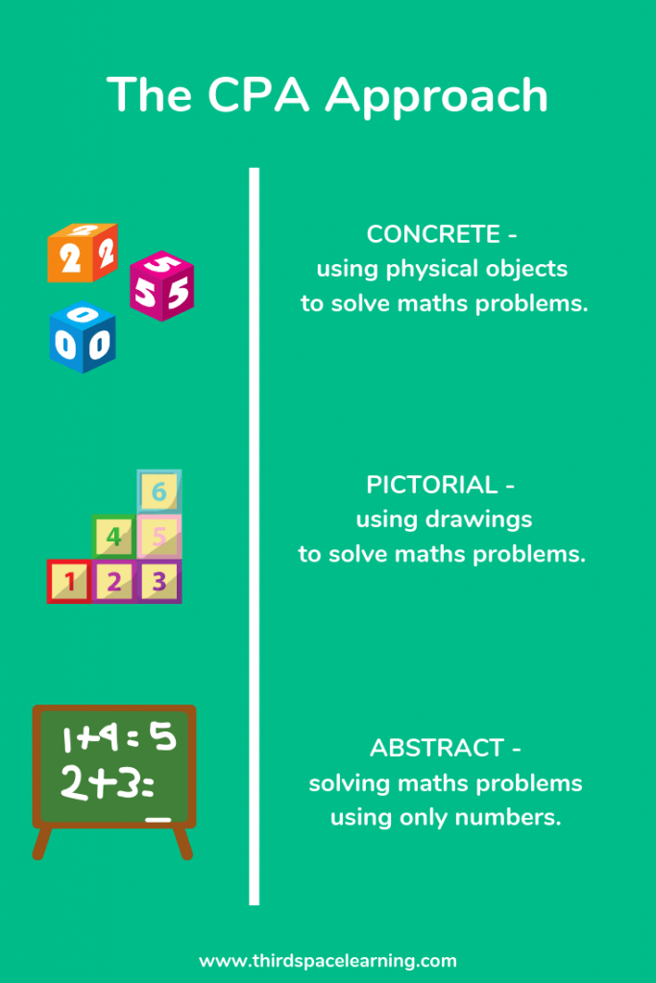

Slide 6
Addition and Subtraction
By the end of Year 1
By the End of Year 2
Read, write and interpret mathematical statements involving addition (+), subtraction (–) and equals (=) signs
Represent and use number bonds and related subtraction facts within 20
Add and subtract one-digit and two-digit numbers to 20, including zero
Solve one-step problems that involve addition and subtraction, using concrete objects and pictorial representations, and missing number problems such as 7 = – 9.
Recall and use addition and subtraction facts to 20 fluently, and derive and use related facts up to 100.
Add and subtract numbers using concrete objects, pictorial representations, and mentally, including:
A two-digit number and ones
A two-digit number and tens
Two two-digit numbers
Adding three one-digit numbers
solve problems with addition and subtraction: using concrete objects and pictorial representations, including those involving numbers, quantities and measures.
Recognise and use the inverse relationship between addition and subtraction and use this to check calculations and solve missing number problems.

Slide 7
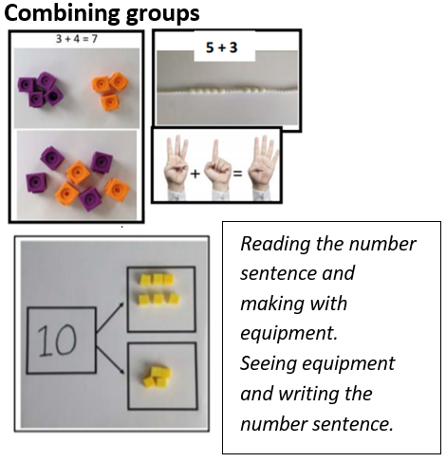
Year 1 – COMBINING GROUPS

Slide 8
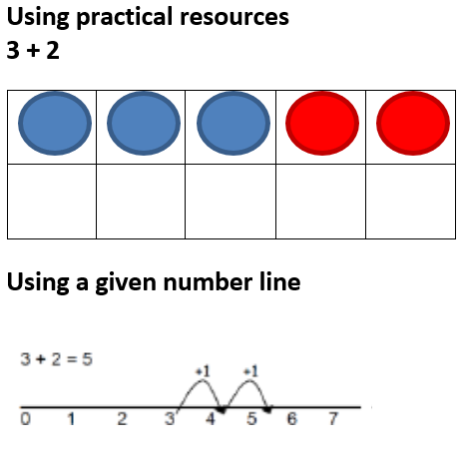
Year 1 – Counting on

Slide 9
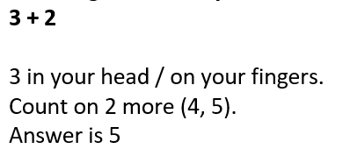
Year 1 – counting on

Slide 10
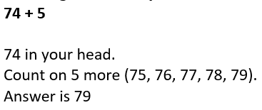
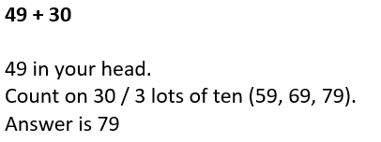
Year 2 – Counting on

Slide 11
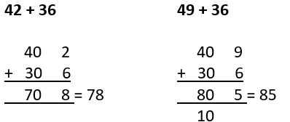
Year 2 – expanded methods

Slide 12
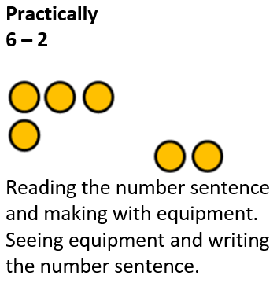
Year 1 – removing GROUPS

Slide 13
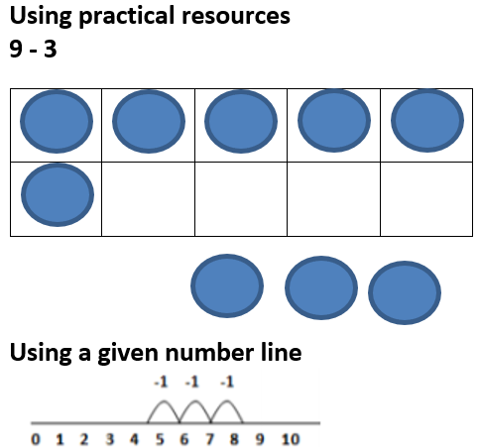
Year 1 – Counting back

Slide 14
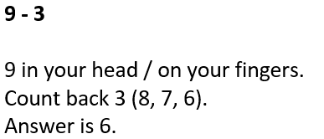
Year 1 – counting back

Slide 15
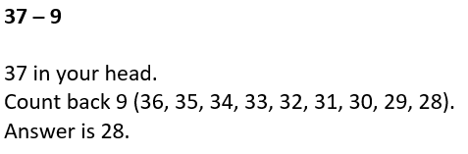
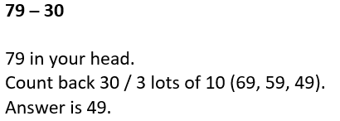
Year 2 – Counting back

Slide 16
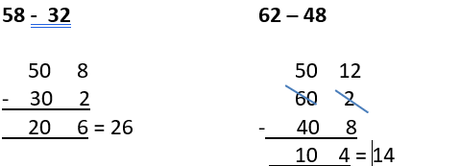
Year 2 – expanded methods

Slide 17
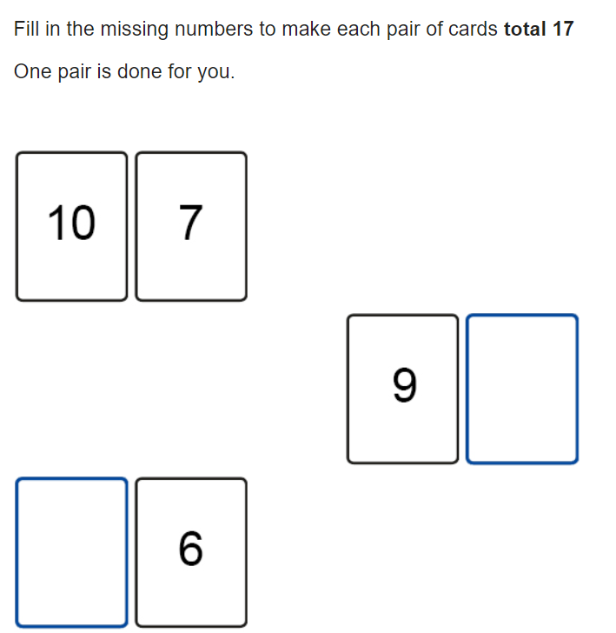

Slide 18
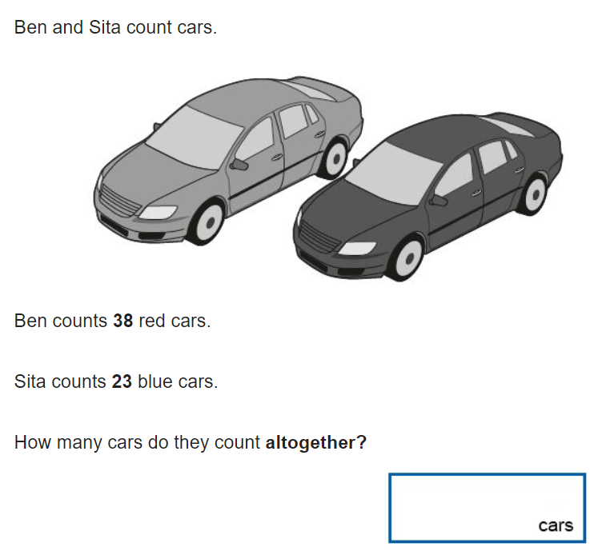

Slide 19
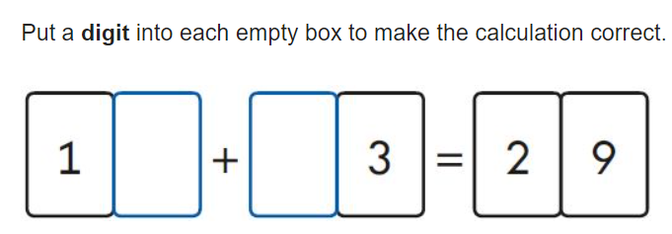

Slide 20
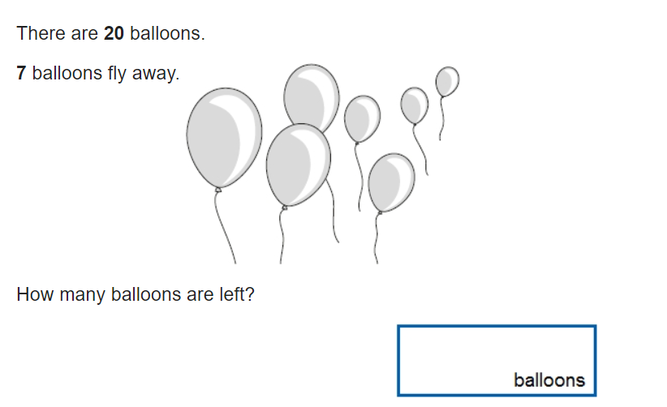

Slide 21
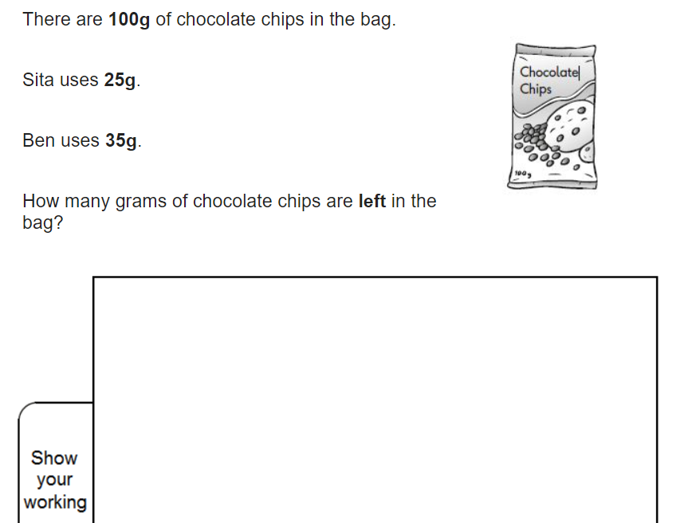

Slide 22
Multiplication and Division
By the end of Year 1
By the End of Year 2
Solve one-step problems involving multiplication and division, by calculating the answer using concrete objects, pictorial representations and arrays with the support of the teacher.
Recall and use multiplication and division facts for the 2, 5 and 10 multiplication tables, including recognising odd and even numbers
Calculate mathematical statements for multiplication and division within the multiplication tables and write them using the multiplication (×), division (÷) and equals (=) signs
Solve problems involving multiplication and division, using materials, arrays, repeated addition, mental methods, and multiplication and division facts, including problems in contexts.

Slide 23
Year 1 – Counting in 2s, 5s and 10s

Slide 24
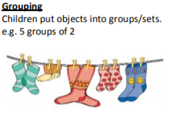
Year 1 - groups

Slide 25

Year 2 – lots of
Multiply with concrete representations. There are 2 sweets in one bag. How many sweets are there in 5 bags?

Slide 26
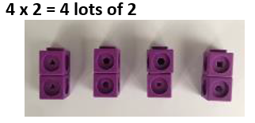
Year 2 – lots of

Slide 27
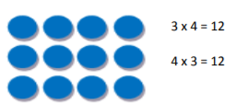
Year 2 - arrays

Slide 28
Year 2 – repeated addition
When solving calculations within their times table knowledge, children will used repeated addition.
4 x 4 = 16

Slide 29
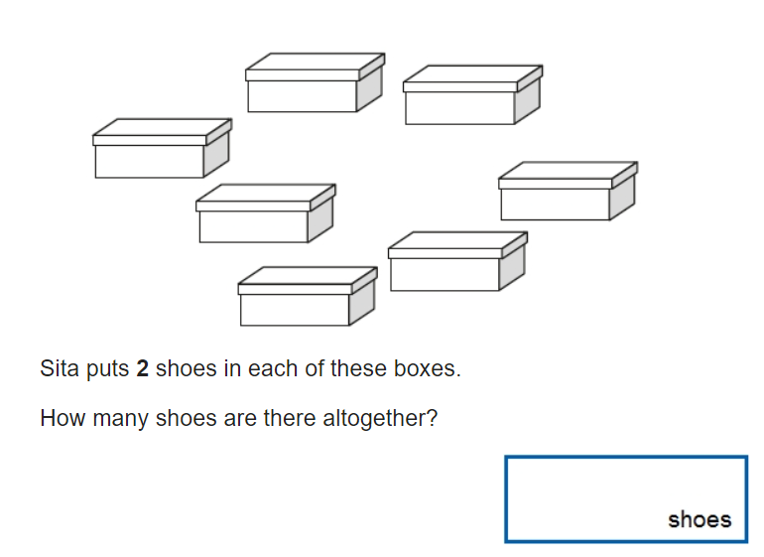

Slide 30
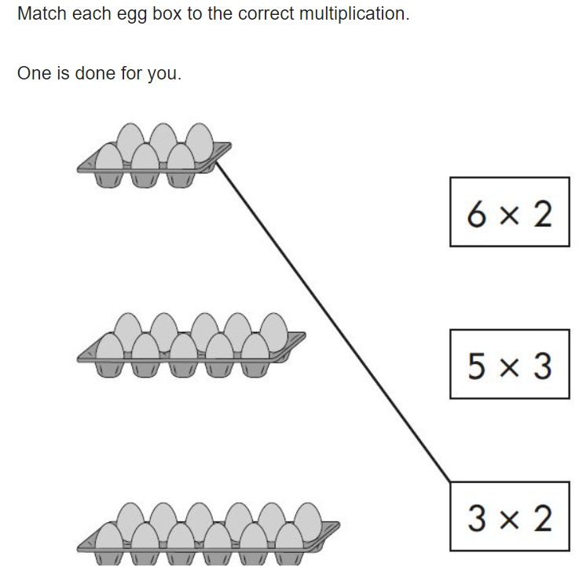

Slide 31
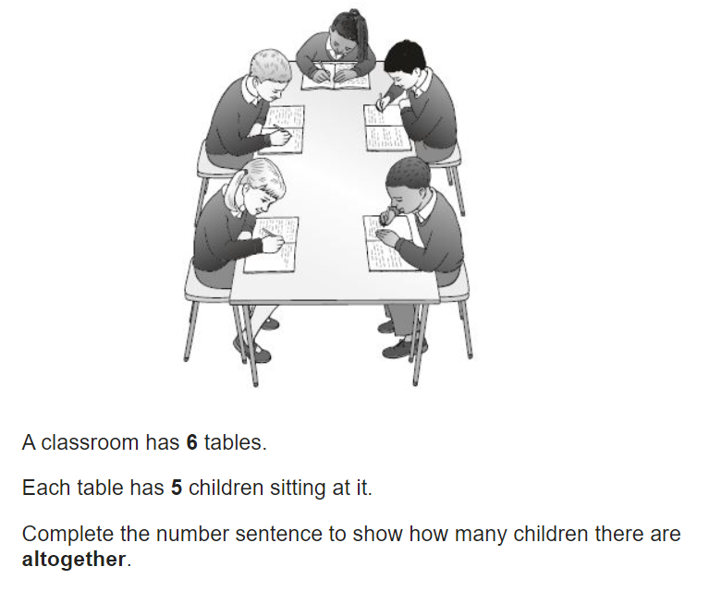

Slide 32
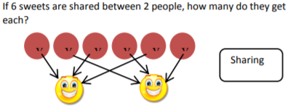
Year 1 and 2 – sharing

Slide 33
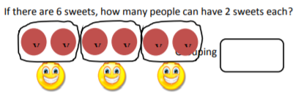
Year 1 and 2 – grouping

Slide 34
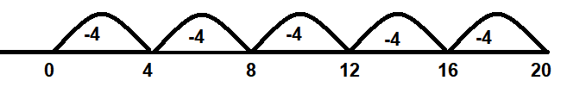
Year 2 – REPEATED SUBTRACTION
20 ÷ 4 = 5

Slide 35
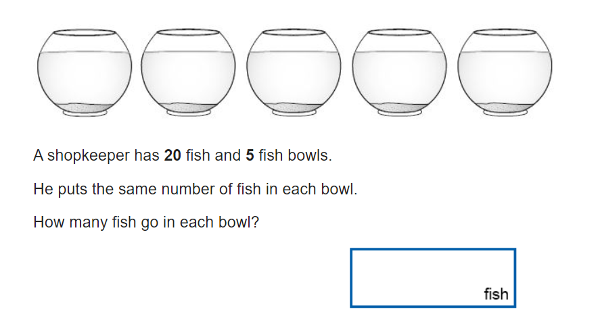

Slide 36
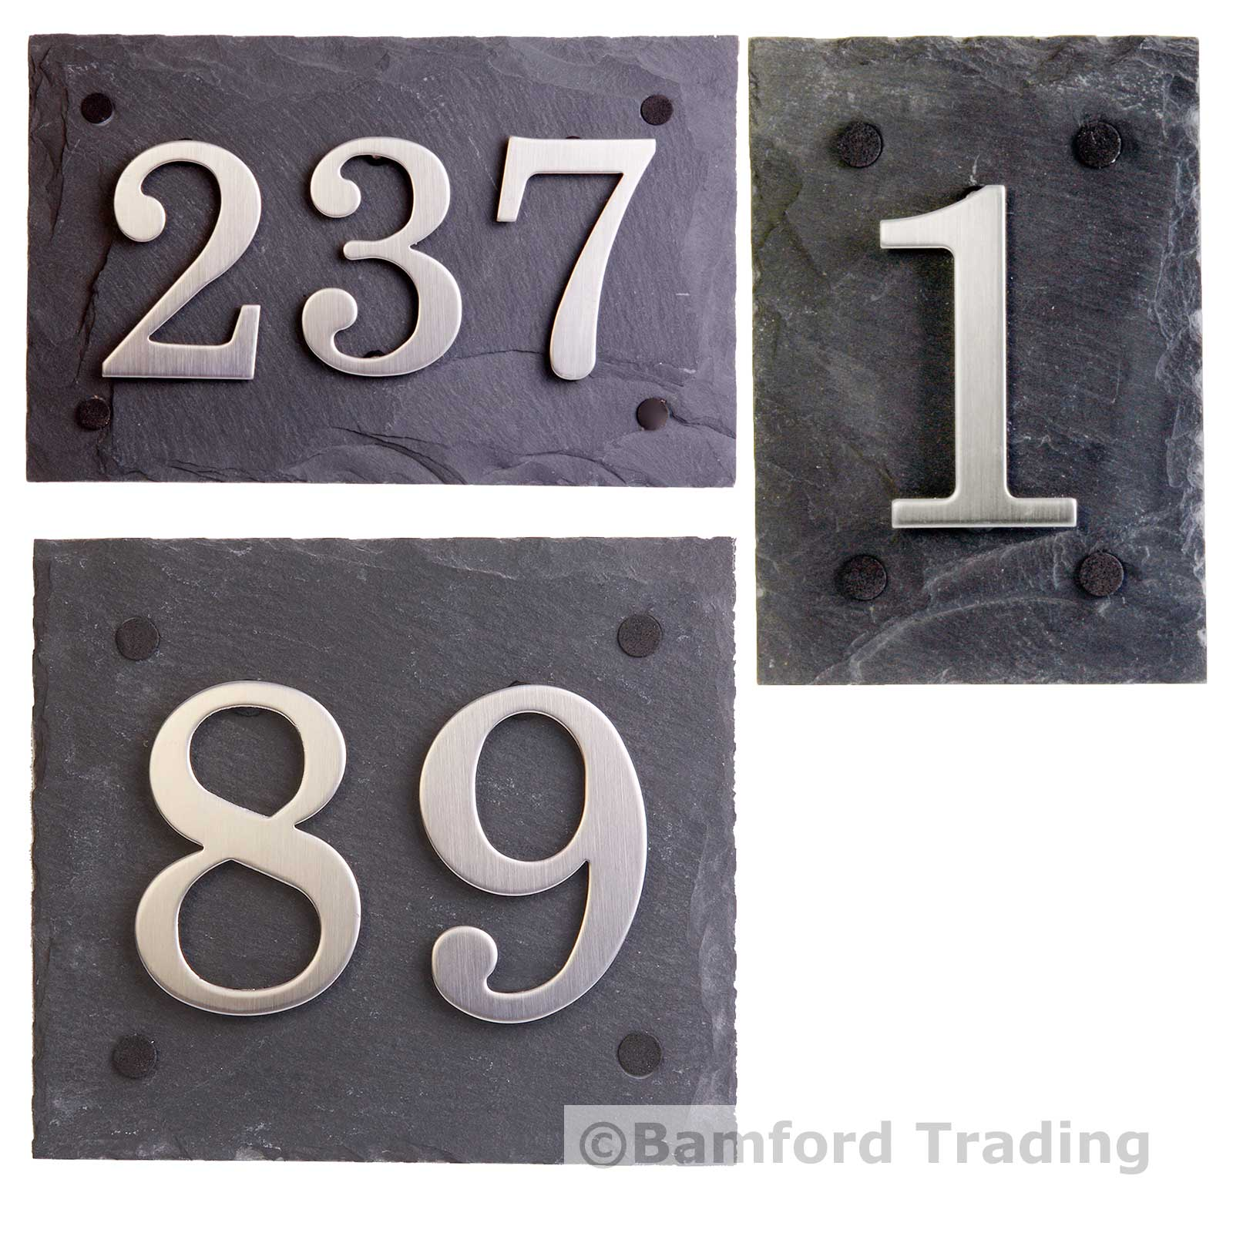
Counting in jumps
Odd and even numbers

Slide 37
cars number plate rearrange the digits to make the largest number - EK13EUN
Add the numbers

Slide 38
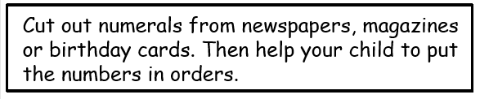
Order your family or toys from smallest to largest

Slide 39
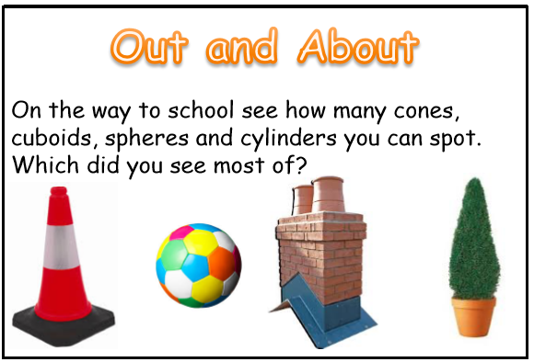

Slide 40
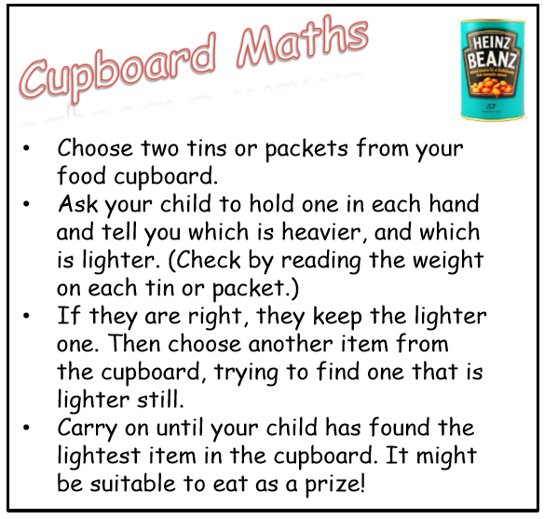

Slide 41
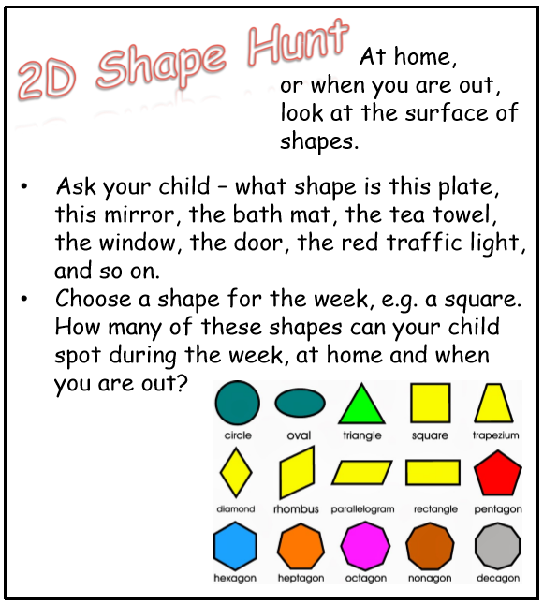

Slide 42
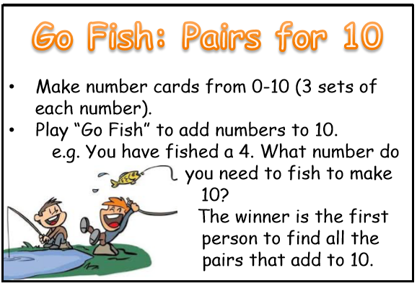

Slide 43
card game pairs snap higher or lower
21

Slide 44
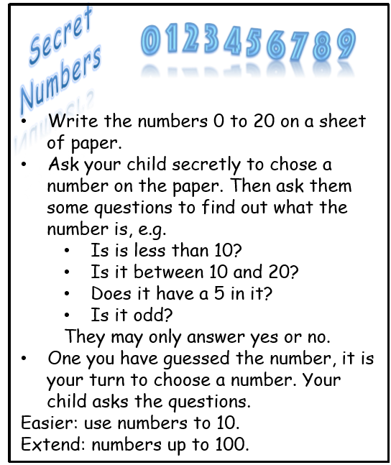

Slide 45
BUILDING SOLID FOUNDATIONS
Baking at home
Handling money
Identify coins.
How much money do I have?

Slide 46
BUILDING SOLID FOUNDATIONS
Number Facts and Number Bonds
Random quick fire questions
Rock, paper, scissors
Dice, playing card, dominoes

Slide 47
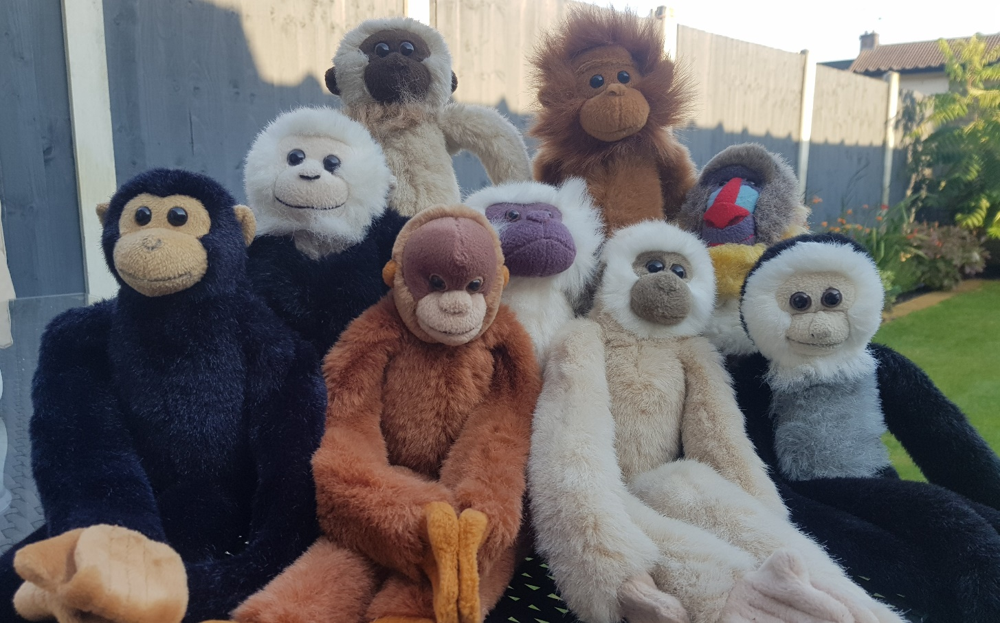
BUILDING SOLID FOUNDATIONS
Maths Monkeys

Slide 48

BUILDING SOLID FOUNDATIONS
Numbots

Slide 49
ALWAYS HERE TO HELP.
Thank you for your time this morning

