Slide 1
Welcome to our Nursery workshop

Slide 2
Important Information
Share books: These are changed weekly on a Thursday. Please see the guidance sheet for additional activities to support reading at home. Children are currently given a share book to be read to at home.
Leave books and home school diaries in book bags. Book bags to be in school everyday.
Please add a comment in the Home School Diary to let us know you have shared the story at home.
Book bags are important to have as not all the books fit into a backpack.
Ensure clothes and footwear are labelled.
Notes:
Bookbag check

Slide 3
Important Information
Ensure the office have an updated list of contact numbers
If someone different is collecting your child, we must be informed and that person must bring ID.
The school office must also be notified if your child is attending an appointment during school time and of any absences.
*There is a 48-hour rule with sickness*
Please let us know if your child has come into contact with childhood illnesses such as chicken pox and chest infections.
Notes:
Bookbag check

Slide 4
Important Information
PE: Thursday. We will start to use the hall for circle games and start to change for PE in the Spring Term.
Please make sure all clothing is named. No earrings to be worn for PE and hair should be tied back.
Additional items required:
Wellies
Spare change of clothes
Book bag everyday – Please check this for letters daily.
Return the reading book and reading record daily.
All items to have names written in them.
Water bottles – named.

Slide 5
Read Write Inc.
Read, Write Inc is a phonic programme that is taught everyday. The children will learn sounds, letters and then use this knowledge to start reading words. They will also take part in daily letter formation practise which will support their writing.
We will start Read Write Inc. in the summer term to help the children with the transition to Reception.
We have started Phase 1 Phonics- Environmental sounds.
This phase focuses on developing children’s speaking, listening and awareness of sound. Developing these skills creates foundations for when children begin to learn their letters and sounds during Read Write Inc. During this phase, your child will begin to distinguish between different sounds within their environment and may begin to show an awareness of rhyme and alliteration.

Slide 6

Wow Moments
If your child does something “wow” at home, please let us know!
Examples
Writes their full name
Learns to ride a bike
Moves up a class in swimming
Fill in the wow moment sheet and these will be shared with the rest of the class.

Slide 7
Supporting learning at home
Sharing books, talking about the pictures.
Read/share books at least 3 times a week.
Encourage mark making, shopping lists etc.
Encourage children to talk.
Practise counting at any time: I.e. climbing the stairs, shopping, walking to school etc.
Play simple board games.
Sing number rhymes and songs together.
Practise putting on coats, fastening buttons and zips etc.

Slide 8


Assessment
Assessments are made continuously through observations made by staff.
In EYFS, the majority of our assessment is based on photographs, videos and dialogue from the children.
As the children progress throughout the year, they will begin to use Working Books which will be sent home at the end of the year.
Any areas of concern in your child's learning will be discussed with you at parent consultation meetings.

Slide 9

Tapestry

Slide 10
Information Pack
Look out for this pack in your child’s book bag:
2D Shape mat
WOW moments sheet
Pencil control sheet
A Parent's Guide to Phase 1 Phonics
Number word mat 0-10
Help your child with reading
Tapestry information

Slide 11

Visit our school website!
Visit www.ghyllgroveprimaryschool.co.uk
Here you will find everything you need about our school.
Each class has their own page; here you will find important dates, homework tasks, newsletters and curriculum information.
These pages are updated regularly with photographs of what the children have learning each week.

Slide 12
Class Pages – School Website
To access our class pages, please click the following:
Menu
Children
Class Pages
Nursery and Early Years
Select the Class Page
On these pages you will find useful information, important dates, our daily routine and also what we are learning each week.

Slide 13
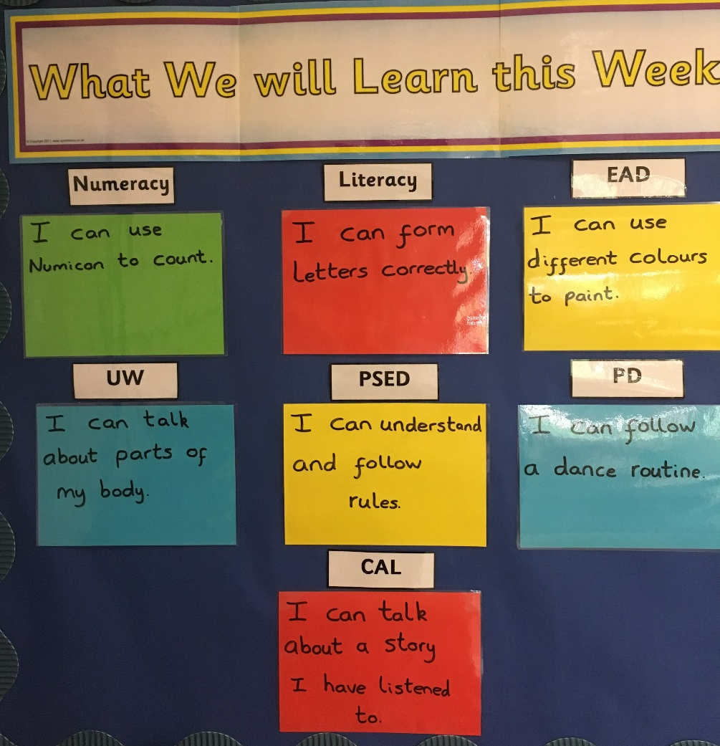
What we will learn each week
Every week these are changed to inform you of what the children will be learning in each area of the curriculum.

Slide 14

Contact Us
Phone: 01268 450067
Email: parents@ghyllgrove.essex.sch.uk
You can also keep updated by following us on Twitter: @Ghyllgrove

